Slide 1




CAPSTONE
PROJECT
Presented by: Mirudhula L

Slide 2

SUPERSTORE
DATASET
INFORMATICA

Slide 3
Informatica ETL (Extract, Transform, Load) is a powerful tool used for data integration and management. It allows organizations to extract data from various sources, transform it into a format suitable for analysis, and load it into a data warehouse or other target system.
INFORMATICA

Slide 4

03
DATASET INTRODUCTION
In this presentation, we will analyze and process the Superstore dataset, which provides detailed transactional data about a retail store's operations. The dataset comprises 9,994 records and contains critical information such as product categories, sales figures, profits, discounts, customer details, and shipment information across various regions in the United States.
We will demonstrate how this dataset can be leveraged to uncover valuable business insights. By using advanced data processing tools, we aim to explore patterns in sales performance, customer segmentation, regional trends, and profitability. Through this, we hope to highlight the importance of data analytics in making informed decisions to drive business success.

Slide 5
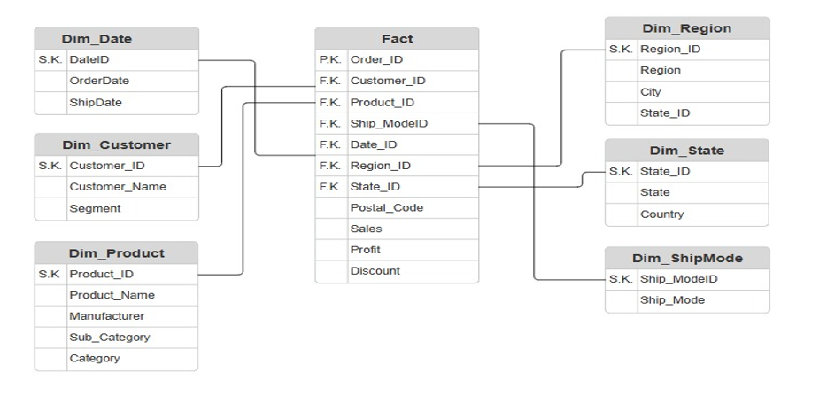
DATA MODEL DIAGRAM

Slide 6

STEPS
1
2
3
STAGING
DIMENTIONALITY
ANALYTICS
Perform source load of the given dataset. The staging area is essential in Informatica ETL because it provides an intermediary stage where data can be processed, validated, cleaned, transformed and optimized before being loaded into the target system. It ensures that the data being loaded into the target system aligns with the intended use of that data and results in accurate and reliable analytics
Convert the source data into dimensions and fact table(s). Dimensionality reduction is an essential component of Informatica ETL because it enables the processing, analysis and interpretation of data, especially in large datasets, by reducing complexity, improving performance, removing redundant features and selecting the essential features required for successful data analysis.
Data analytics is a process that involves processing, examining and interpreting data, to make informed decisions and gain valuable insights into a given area of focus. Performing data analytics in Informatica ETL allows individuals and businesses to gain valuable insights into their operations, enabling them to make better decisions, enhance strategies, improve customer experience, and improve overall performance.

Slide 7
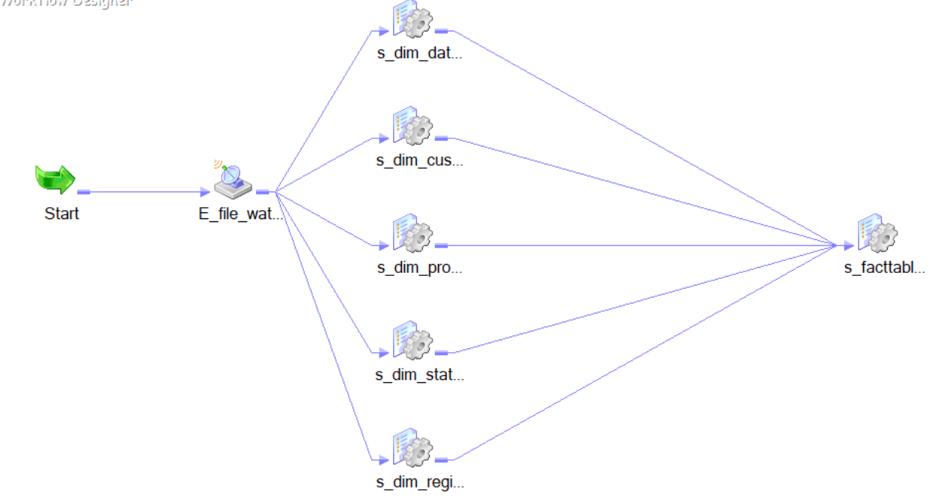
FINAL WORKFLOW

Slide 8
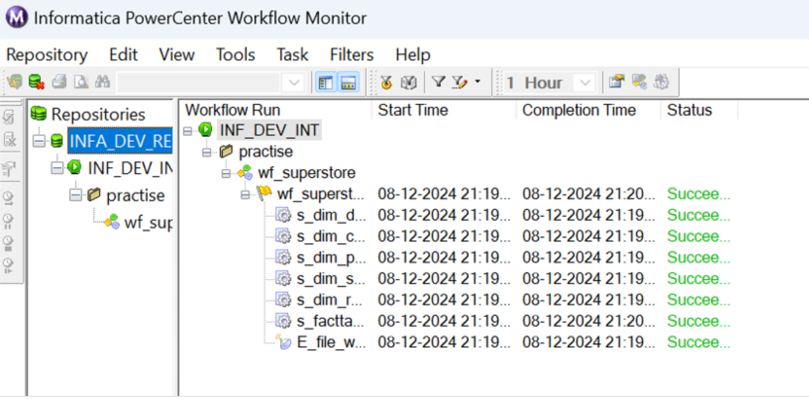
FINAL WORKFLOW

Slide 9
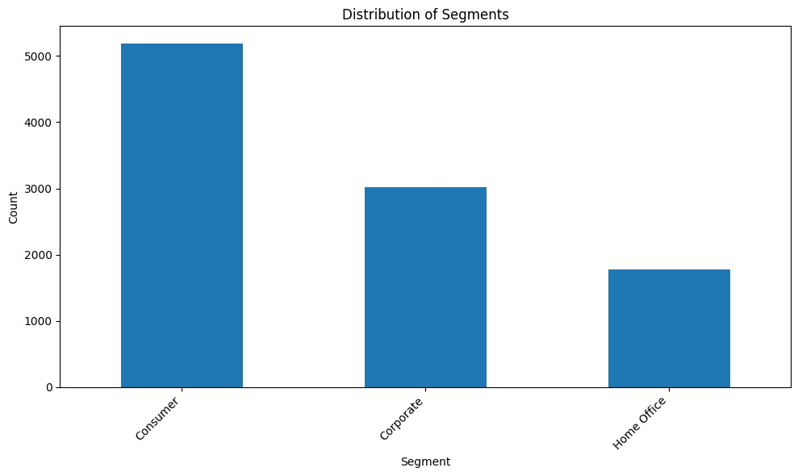
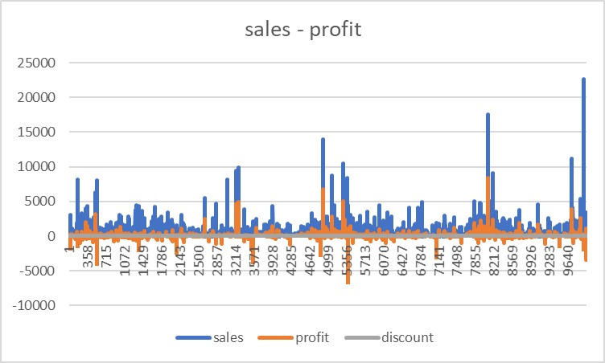
ANALYTICS

Slide 10

INDICATORS
The Superstore dataset is a comprehensive retail dataset that provides insights into the sales, profitability, and operational aspects of a retail business. It contains transactional data across various product categories, customer segments, and geographical regions.
Key metrics such as Sales, Profit, and Discount measure the financial performance and efficiency of the store. Product details like Category, Sub-Category, and Manufacturer highlight the variety of goods sold, while Customer Segmentation (e.g., Consumer, Corporate, Home Office) provides insights into different customer groups and their purchasing patterns.
The dataset also includes geographical information (City, State, Region, and Country), which helps identify regional sales trends and market potential. Operational data, such as Order Date, Ship Date, Ship Mode, and Quantity, reflects the store's logistics and supply chain efficiency.
By analyzing the Superstore dataset, businesses can uncover patterns and trends, optimize inventory, enhance customer targeting, and improve overall operational efficiency. It is a valuable resource for understanding the dynamics of retail performance and supporting data-driven decision-making.

Slide 11

THANK YOU
MIRUDHULA.L

